Slide 1
Operating system and system programming (25CS2104E)
Linux Signal-Based Process Communication and Control System
Review-I
Team Members:
Name Roll Number
R.Radhakrishna 2520090063
R.Jagadeesh 2520090030
P.Vedadri 2520090060
Under the Esteemed Guidance of
Raghupathi M
CSE Department

Slide 2
Contents
Abstract
Introduction
Hardware and Software requirements
System Architecture
Conclusion

Slide 3
Abstract
Modern distributed systems require efficient inter-process communication mechanisms to coordinate activities between multiple processes. This project aims to develop a Linux Signal-Based Process Communication and Control System that leverages POSIX signals for real-time process synchronization and control. The system addresses the challenge of managing multiple processes with varying computational loads and priorities while maintaining low-latency communication. Traditional IPC mechanisms like pipes and message queues introduce overhead;

Slide 4
Introduction
What are Signals?
Signals are software interrupts that provide a way to handle asynchronous events. They are one of the oldest methods of IPC in Unix/Linux.
Key Concepts:
• Signal: A notification sent to a process to indicate that an event has occurred
• Signal Handler: A function that is called when a specific signal is received
• Signal Mask: Blocks/unblocks specific signals from being delivered to a process
Common Signals Used:
• SIGUSR1, SIGUSR2: User-defined signals for custom communication
• SIGCHLD: Sent to parent when child process terminates
• SIGTERM, SIGKILL: Process termination signals
Advantages of Signal-Based IPC:
✓ Simple and lightweight mechanism
✓ Widely supported in all Unix-like systems
✓ Efficient for simple communication patterns

Slide 5
Hardware and Software requirements
List the Requirements in table format
Component | Requirement | Specification
Operating System | Linux Kernel | Linux 3.0+ (Ubuntu/CentOS)
Processor | CPU | Any x86/x64, 1 GHz+
RAM | Memory | Min 512 MB, Recommended 2 GB+
Compiler | GCC | GCC 4.8.5 or higher
Libraries | C Library | glibc 2.17+
Tools | Dev Tools | make, gdb, valgrind
IDE/Editor | Dev Environment | VS Code/Vim/Emacs

Slide 6
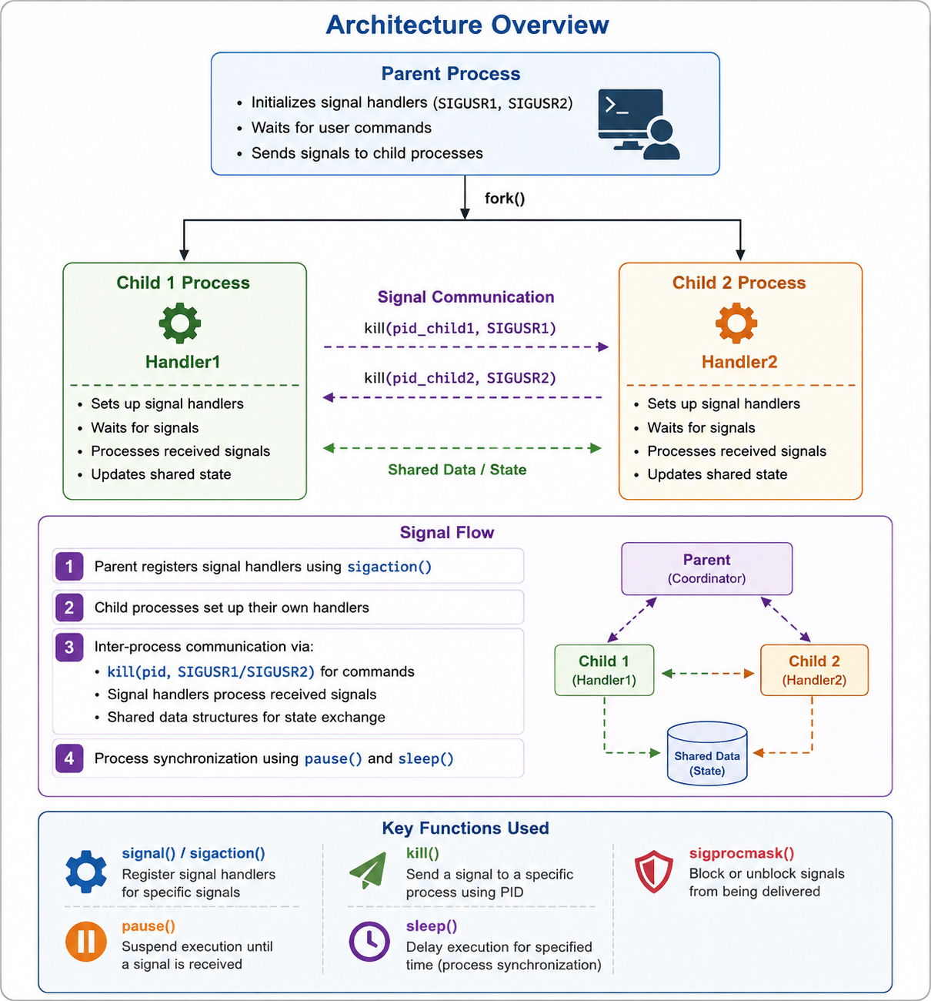
System Architecture

Slide 7
Conclusion
The Linux Signal-Based IPC System demonstrates how POSIX signals can be used for efficient inter-process communication and process control.
Signals such as SIGUSR1, SIGUSR2, and SIGALRM enable lightweight and event-driven communication between processes.
The system uses signal handlers, signal masking, and process synchronization to coordinate parent and child processes.
The master-slave architecture provides an effective approach for monitoring processes and managing their states.
This project provides practical understanding of Linux process management, signal delivery, IPC mechanisms, and low-level system programming.
Overall, signal-based IPC is a simple, lightweight, and efficient solution for real-time process coordination in Linux/POSIX systems.

Slide 8
Thank you

